Slide 1
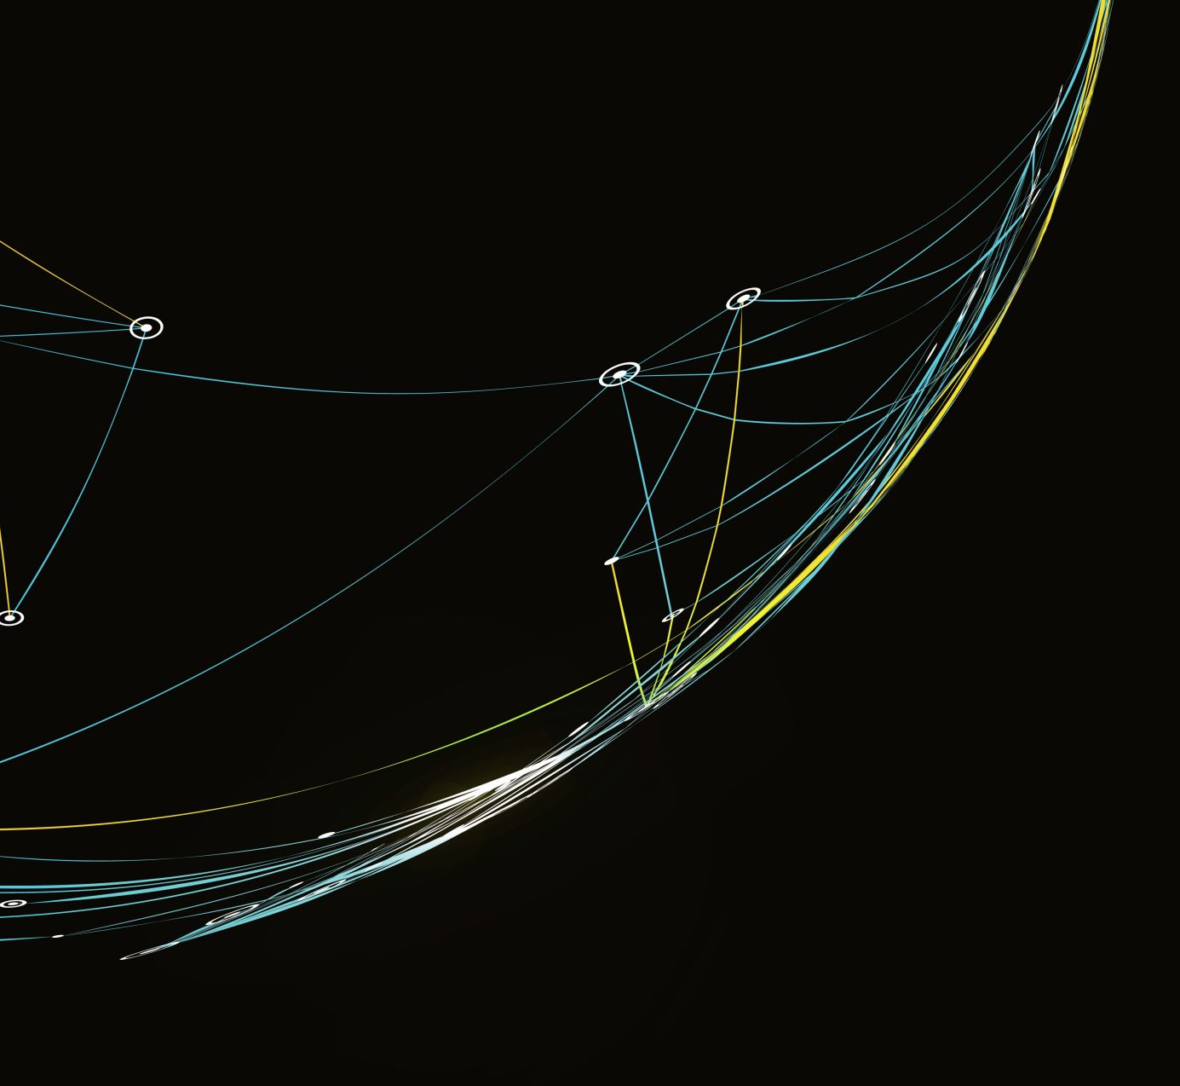
MAE 5419: Low Thrust LEO to GEO Problem
By: Devin Quach

Slide 2
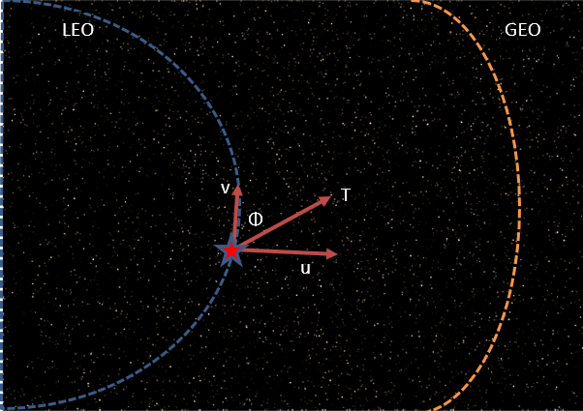
The Goal:
Low Earth Orbit to Geosynchronous Orbit within a Time of Flight
Min Fuel
Obj. Function = Int(|T|)dt
Two-Point Boundary Problem
States: [Radial Distance, Radial Velocity, Horizontal Velocity]
Controls: [Magnitude of Thrust , Angle of Thrust]
Notes:
To min fuel means minimizing T
Obj. Func.
Min Energy – T^2
2 Pt Boundary Problem
Specified Initial and Final states and time
Controls
Phi=0 Positioned to Thrust in orbit, Phi = 90 Thrust outward, Phi = -90 Thrust inward

Slide 3
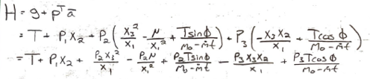
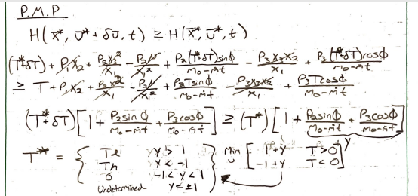
Calculus of Variations:
Hamiltonian & Necessary Conditions
Third necessary condition:
Pontrayagin Minimum Principle to Find Thrust since Thrust is linear in H
Method to Numerically Solve: Variation of Extremals or Steepest Descent

Slide 4
Process of Variation of Extremals:
Guess Initial costates
Perturbating reduced differential equations and controls
Perturbating new states & costates using forward integration
Influence functions: perturbating new Initial costates
Modified to just Px since tf is specified

Slide 5
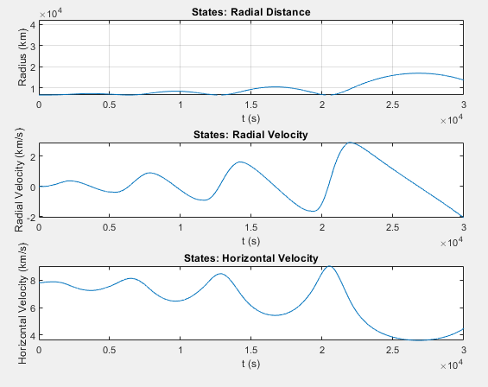
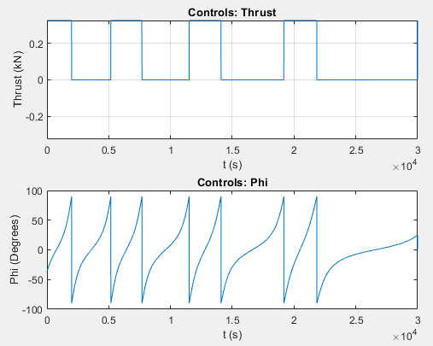
Results:

Slide 6
Debugging/Troubleshooting:
Bootstrap Method:
Initial guess for costates from a simpler version of the problem
Correlation btwn TOF, mdot, and mo
Mdot was small to make mo seem constant
Single Interval for Thrust
Optimal control not unique or non-existent
Remedied to be zero
Tau weighting did not influence much
Did not converge
Influence Matrix becomes NaN

Slide 7
Areas of Improvements: Fixing Influence Function
Creating a Steepest Descent Model
Compare
Modify for free TOF
Adding another boundary condition

